Slide 1
Image compression
‹#›
Notes:
‹#›

Slide 2
Outline
Fundamentals
Some basic compression methods
‹#›
Notes:
‹#›

Slide 3
Image compression
Image compression is minimizing the size in bytes of a graphics file without degrading the quality of the image to an unacceptable level.
The reduction in file size allows more images to be stored in a given amount of disk or memory space.
It also reduces the time required for images to be sent over the Internet or downloaded from Web pages.
‹#›
Notes:
‹#›

Slide 4

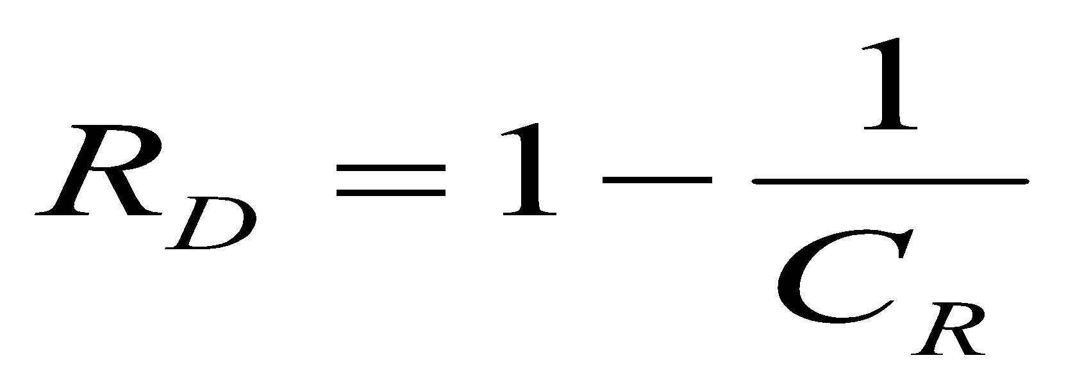
Image compression..
The goal of data compression
Reduce the amount of data required to represent a given quantity of information
Reduce relative data redundancy
n1 and n2 denote the number of information carrying units in two data-sets that represent the same information.
C_{R} is the compression ratio.
‹#›
Notes:
‹#›

Slide 5
Information vs Data
REDUNDANTDATA
INFORMATION
DATA = INFORMATION + REDUNDANT DATA
‹#›
Notes:
‹#›

Slide 6
Redundancies
Three basic data “redundancies” for image compression:
Coding redundancy
Inter-pixel redundancy and
Psycho-visual redundancy
‹#›
Notes:
‹#›

Slide 7
Coding redundancy
Coding redundancy is due to inefficiencies in data representations.
Spatial and temporal redundancy
remove unnecessarily replicated information in the representations of the pixels
Irrelevant information
Remove information ignored by the human visual system.
‹#›
Notes:
‹#›

Slide 8
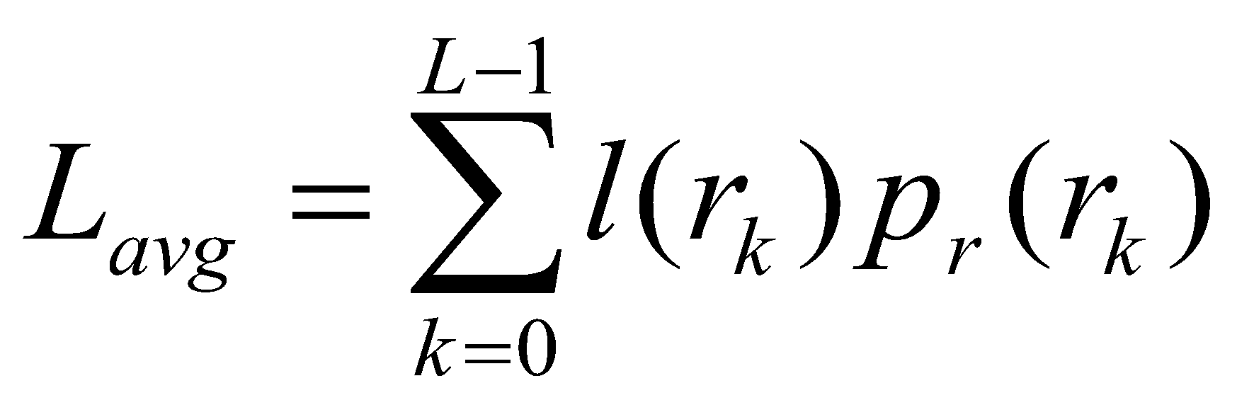
Coding redundancy
The gray level of an image, r_{k} occur with probability p_{r} (r_{k}).
The average of number bits required to represent each pixel
Where
L= number of gray levels.
l( r_{k} ) = number of bits used to represent each value of r_{k.}
‹#›
Notes:
‹#›

Slide 9
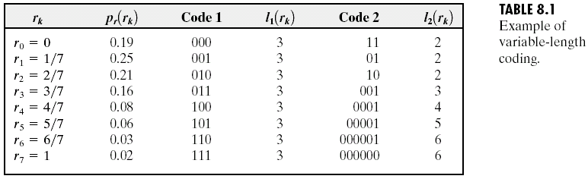
Image Compression
Variable length coding -assign fewer bits to the more probable gray level than less probable ones achieve data compression
‹#›
Notes:
‹#›

Slide 10
Interpixel redundancy
If a pixel value can be reasonably predicted from its neighboring pixels the image is said to contain interpixel redundancy.
Interpixel redundancy depends on the resolution of the image
The higher the resolution of an image, the more probable it is that two neighboring pixels will depict the same object
The higher the frame rate in a video stream, the more probable it is that the corresponding pixel in the following frame will depict the same object.
‹#›
Notes:
‹#›

Slide 11
Psychovisual redundancy
The human visual system does not rely on quantitative analysis of individual pixel values when interpreting an image.
In this process certain information is relatively less important than other – this information is called psychovisually redudant.
Psychovisually redundant image information can be identified and removed – a process referred to as quantization.
Quantization eliminates data and therefore results in lossy data compression
‹#›
Notes:
‹#›

Slide 12
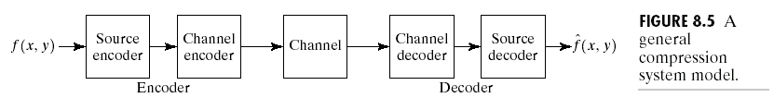
Image compression models
A compression system consists of two structural blocks: an encoder and a decoder
Encoder is made up of source encoder and a channel encoder
‹#›
Notes:
‹#›

Slide 13
Image compression models
Source encoder
Reduce or eliminate any coding, inter-pixel or psychovisual redundancies in the input image
The corresponding source encoder-
mapper,
quantizer and
symbol encoder
Mapper
transforms the input data into a format designed to reduce inter-pixel redundancies
Reversible process
‹#›
Notes:
‹#›

Slide 14
Image compression models….
Quantizer
Reduce psycho-visual redundancy
Irreversible operation.
The symbol encoder
Creates a fixed or variable-length to represent quantizer output and maps the output in accordance with the code
A variable length code is used to represent the mapped and quantized data set
Source decoder contains only two components: a symbol decoder and inverse mapper because of irreversible operation of quantizer
‹#›
Notes:
‹#›

Slide 15
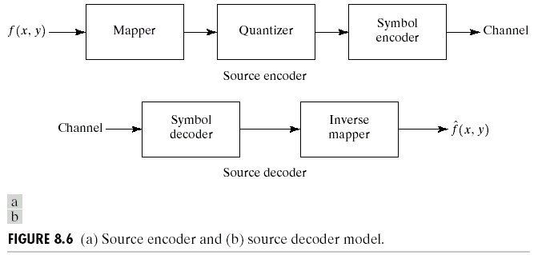
Image Compression
‹#›
Notes:
‹#›

Slide 16
Lossless compression
Provides limited compression capabilities - information theory provides a mathematical framework for (and good measures of) the levels of compression that can be achieved
Principally motivated by application specifications – data loss may be unacceptable
Medical imaging – diagnostic quality must be maintained
Satellite imaging – image acquisition costs are astronomical
‹#›
Notes:
‹#›

Slide 17
Huffman coding
Provides a data representation with the smallest possible number of code symbols per source symbol.
Source reductions
Create a series of source reductions by ordering the probabilities of the symbols and then
combine the symbols of lowest probability to form new symbols recursively.
This step is sometimes referred to as “building a Huffman tree” and can be done statistically
Code assignment
When only two symbols remain, retrace the steps in (1) and assign a code bit to the symbols in each step
‹#›
Notes:
‹#›

Slide 18
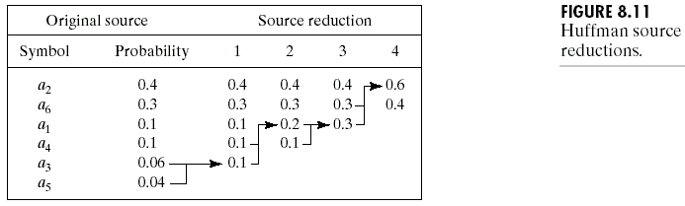
Image Compression
‹#›
Notes:
‹#›

Slide 19
Arithmetic coding
Provides a data representation where the entire symbol sequence is encoded as a single arithmetic code word (which is represented as an interval of real numbers between 0 and 1)‏
Arithmetic code construction is done in 3 steps
Subdivide the half-open interval [0,1) based on the probabilities of the source symbols
For each source symbol recursively
• Narrow the interval to the sub-interval designated by the encoded symbol
• Subdivide the new interval among the source symbols based on probability
‹#›
Notes:
‹#›

Slide 20
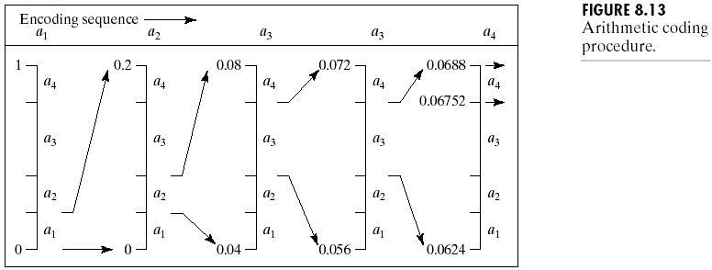
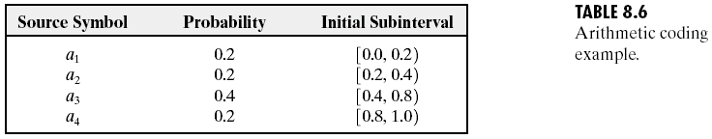
Image Compression
‹#›
Notes:
‹#›

Slide 21
Run-length coding
Provides a data representation where sequences of symbol values of the same value are coded as “run-lengths”
• 1D – the image is treated as a row-by-row array of pixels
• 2D – blocks of pixels are viewed as source symbols
Works well for simple, artificial images
Input data 2222222222266666666666666999999999999
Code 2,11 6,14 9,12
‹#›
Notes:
‹#›

Slide 22
Predictive coding
Provides a data representation where code words express source symbol deviations from predicted values (usually values of neighboring pixels)‏
Predictive coding efficiently reduces interpixel redundancies
• 1D & 2D – pixels are predicted from neighboring pixels
• 3D – pixels are predicted between frames as well
Input data 222222222226666666666666699999999999999999
Code 200000000004000000000000030000000000000000
‹#›
Notes:
‹#›

Slide 23
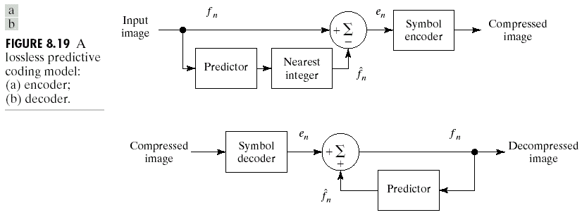
Lossless predictive coding
‹#›
Notes:
‹#›

Slide 24
Lossy compression
Provides higher compression capabilities - is usually specified in terms of application
Principally motivated by application specifications –
• Distortions are tolerable.
• The observers visual system may not be able to point these distortions
‹#›
Notes:
‹#›

Slide 25
Transform coding
In transform coding a linear transform is used to map the image data into a set of transform coefficients.
The image is subdivided into smaller subimages before the transformation computation to reduce computational complexity
The goal of the transformation process is to minimize the variance of the pixels of the subimages as much as possible
Transformation coding can be
• Adaptive – each subimage is treated in an individual manner
• Non-adaptive – all subimages are treated in the same way
‹#›
Notes:
‹#›

Slide 26
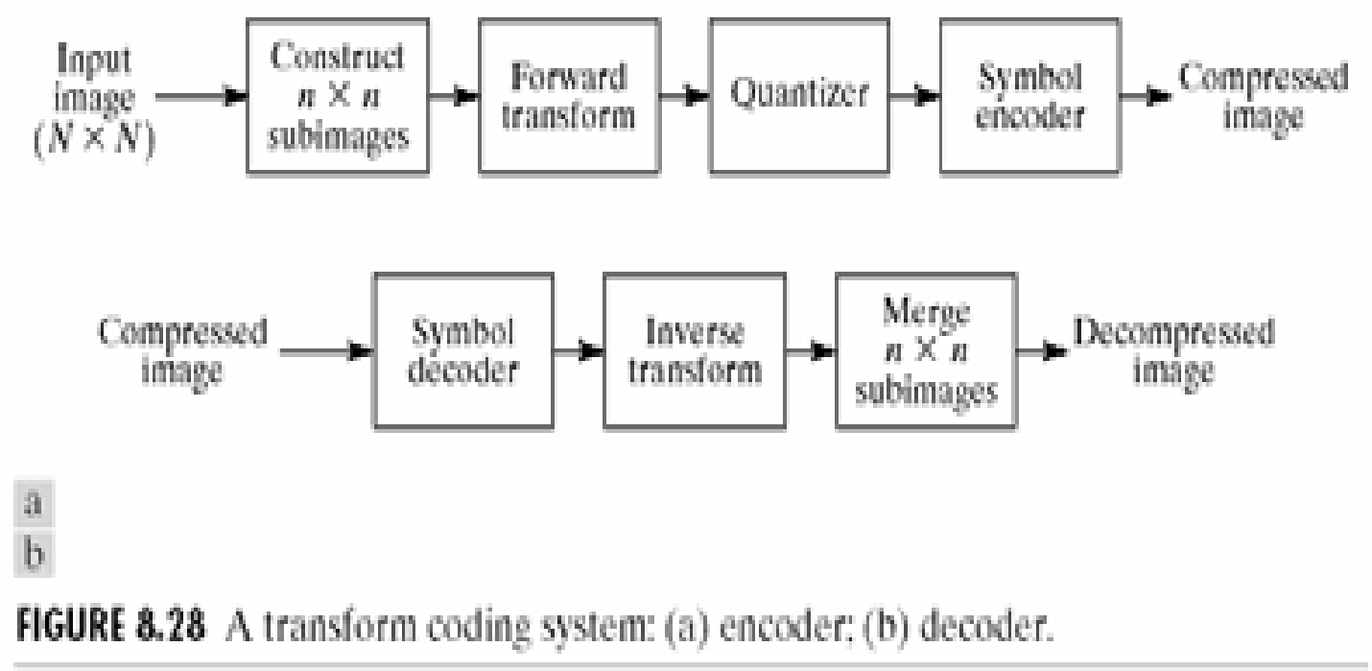
Transform coding
‹#›
Notes:
‹#›

Slide 27
JPEG
Joint Photographic Experts Group
‹#›
Notes:
‹#›

Slide 28
JPEG Encoding Process outlined
1. Color Space Transformation
2. Downsampling
3. Discrete Cosine Transform
4. Quantization
5. Entropy Coding
‹#›
Notes:
‹#›

Slide 29
Color Space Transformation
Color space is transformed
from RGB to YCbCr
‹#›
Notes:
‹#›

Slide 30
Downsampling
Cb and Cr components are downsampled
Possible ratios in JPEG:
4:4:4
4:2:2
4:2:0 (most common, reduce by factor 2 in both directions)‏
‹#›
Notes:
‹#›

Slide 31
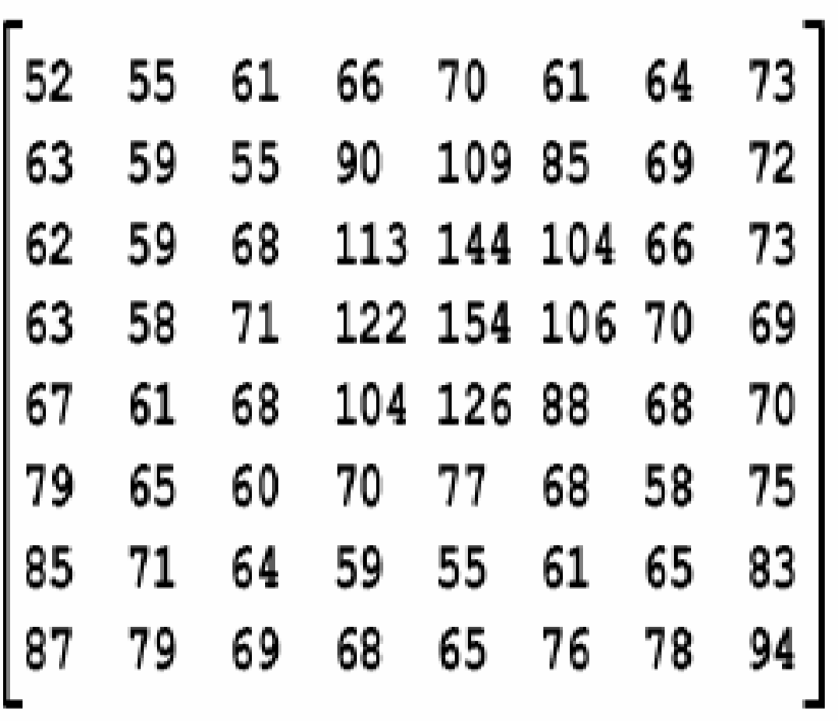
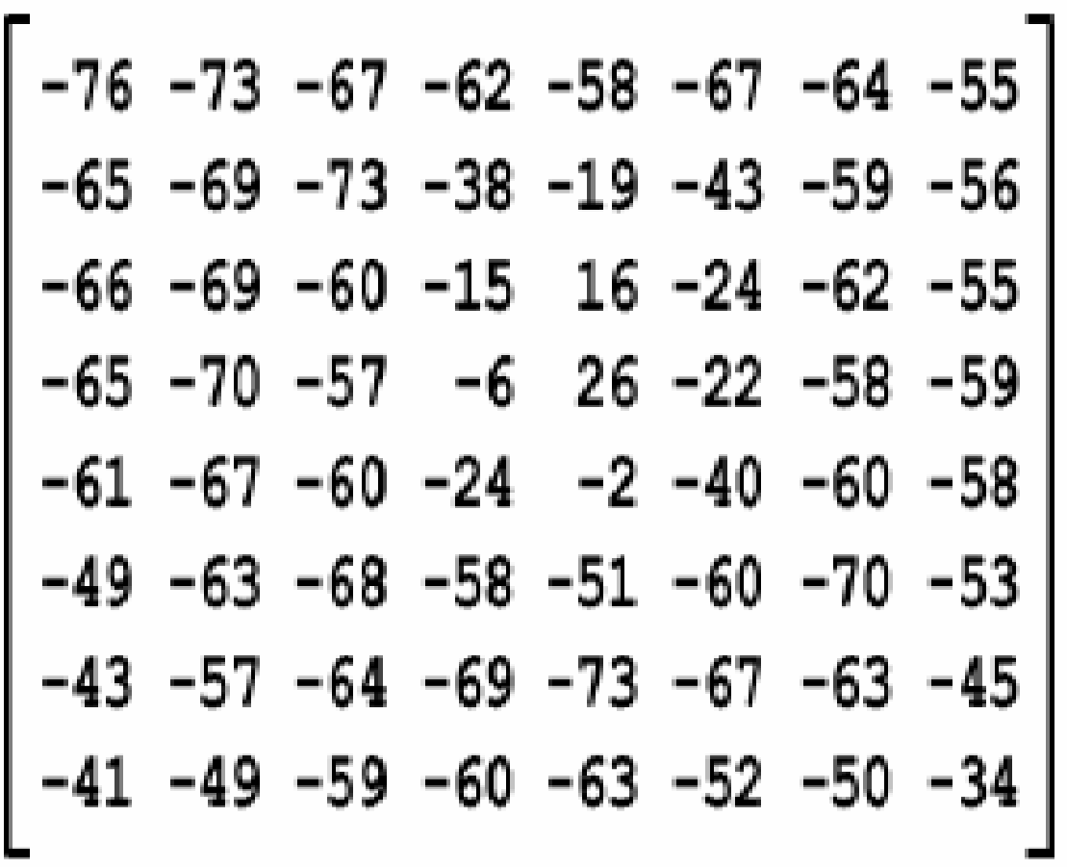
Discrete Cosine Transform
Transformation to frequency domain is done in 8×8 blocks (matrices)‏
All values in the matrix are first shifted down (subtracted) by 128
‹#›
Notes:
‹#›

Slide 32
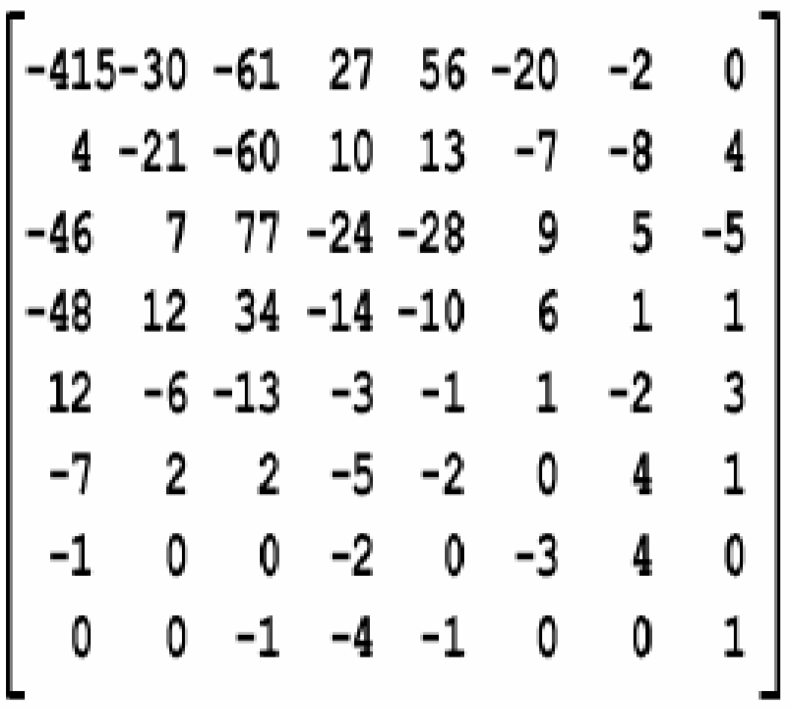
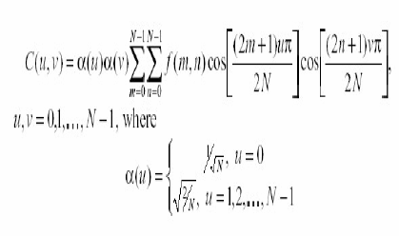
DCT
DCT is applied
values are rounded to integers
2-D DCT transforms the image into linear combination of these patterns
‹#›
Notes:
‹#›

Slide 33
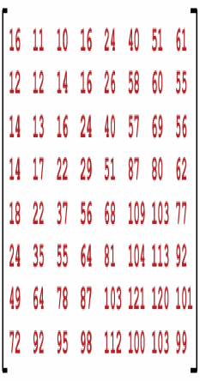
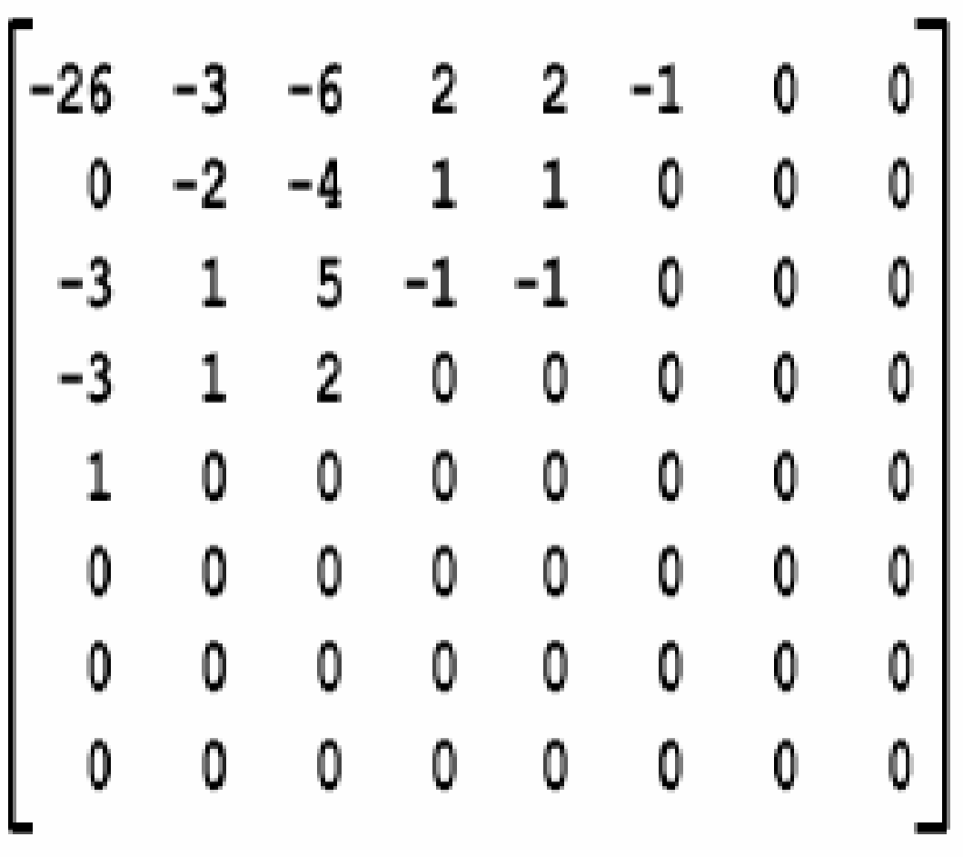
Quantization
Values in the transformed matrix are divided by corresponding values in
Quantization matrix.
Round (-415/16)‏
= Round(-25.93)‏
= -26
‹#›
Notes:
‹#›

Slide 34
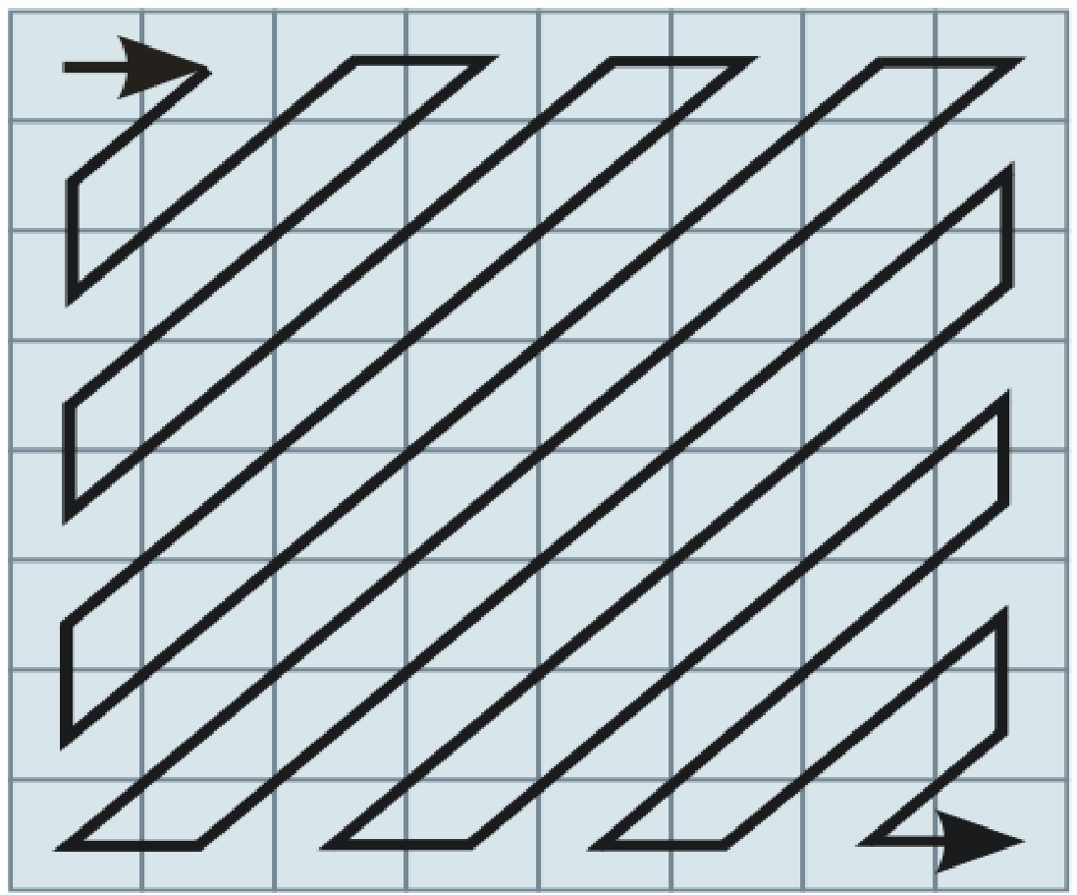
Entropy Coding
The matrix is sequenced using zig-zag scanning, that groups similar frequencies together
The sequence is compressed using lossless RLE and the coded with Huffman or Arithmetic coding.
‹#›
Notes:
‹#›

Slide 35
Decoding Process
Basically the encoding done backwards
Reconstruct the Huffman/RLE stream to a sequence
Arrange the sequence to a matrix using the zigzag scanning backwards
Multiply the matrix by quantization table
Perform inverse DCT
Shift the values by +128
Transform back to RGB color space
‹#›
Notes:
‹#›

Slide 36
Pros & Cons
Low complexity
Memory efficient
Reasonable coding efficiency
Excellent color range
Generally excellent image quality / file sizes for photographs
Compatibility (hardware & software)‏
Adjustable image quality
‹#›
Notes:
‹#›

Slide 37
Pros & Cons
Single resolution
Single quality
No target bit rate
No regions of interest
Compression algorithm occasionally results in suboptimal
visual results when used on graphics art and text
No support for transparency.
No support for animation
‹#›
Notes:
‹#›

Slide 38
Thank You
‹#›
Notes:
‹#›

